Slide 1
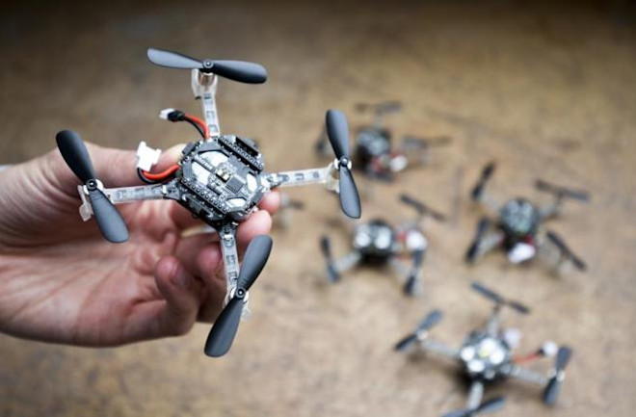
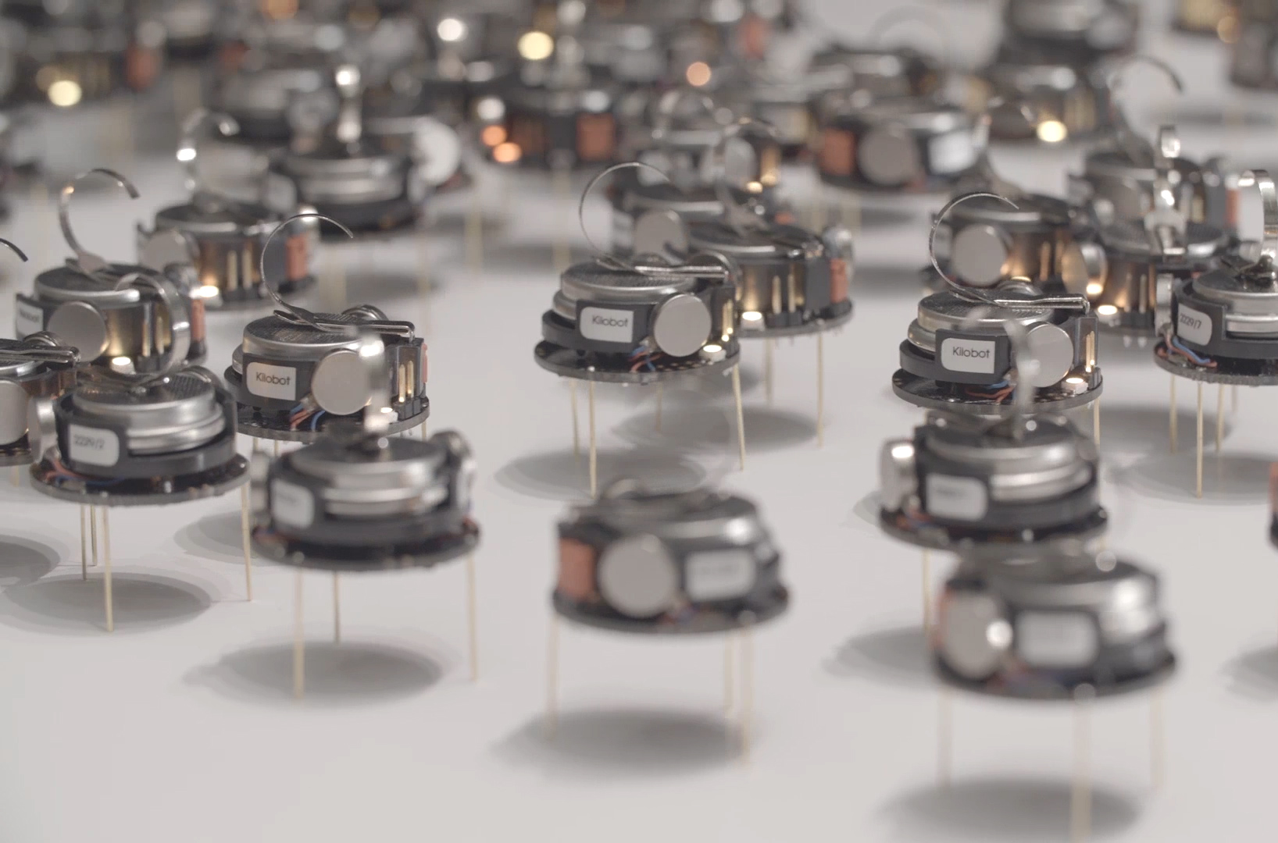
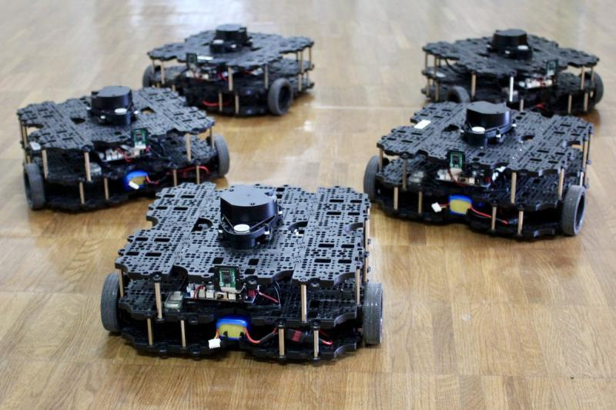

ECE693H, Spring 2025: Multi-robot System Design
“Intelligence 1”
Dr. Daniel Drew

Slide 2
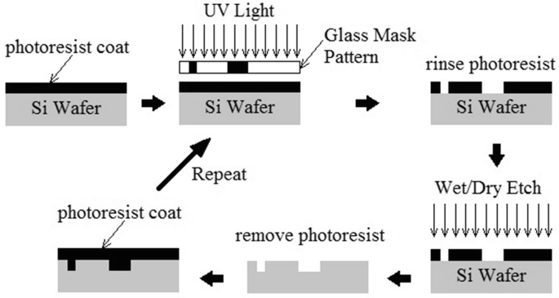
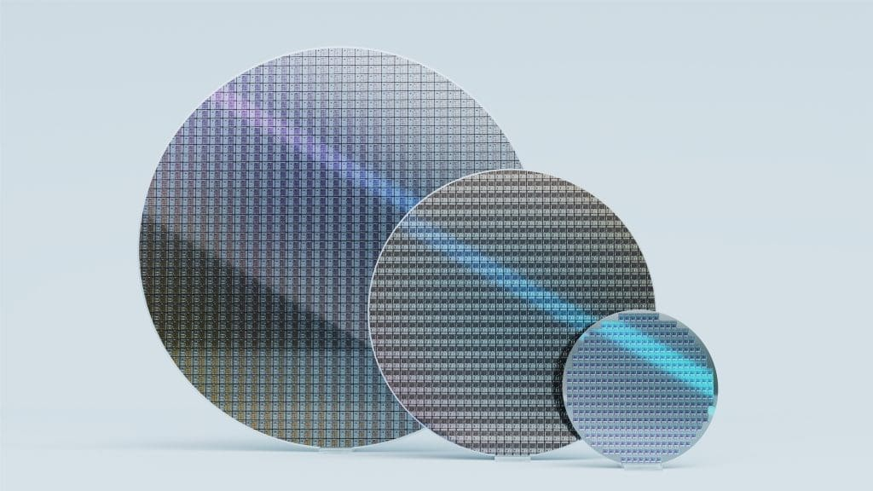
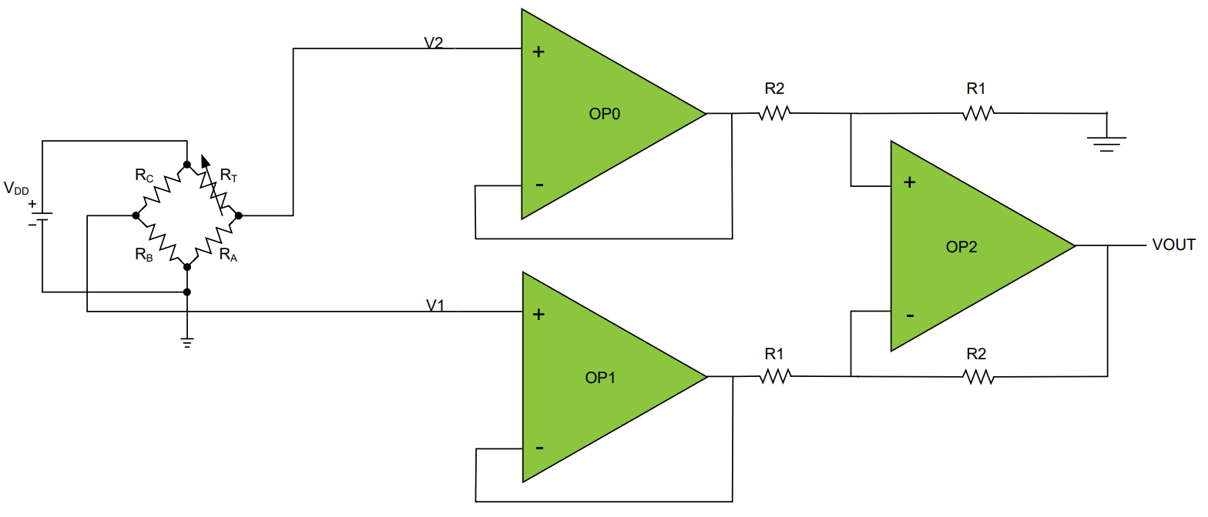
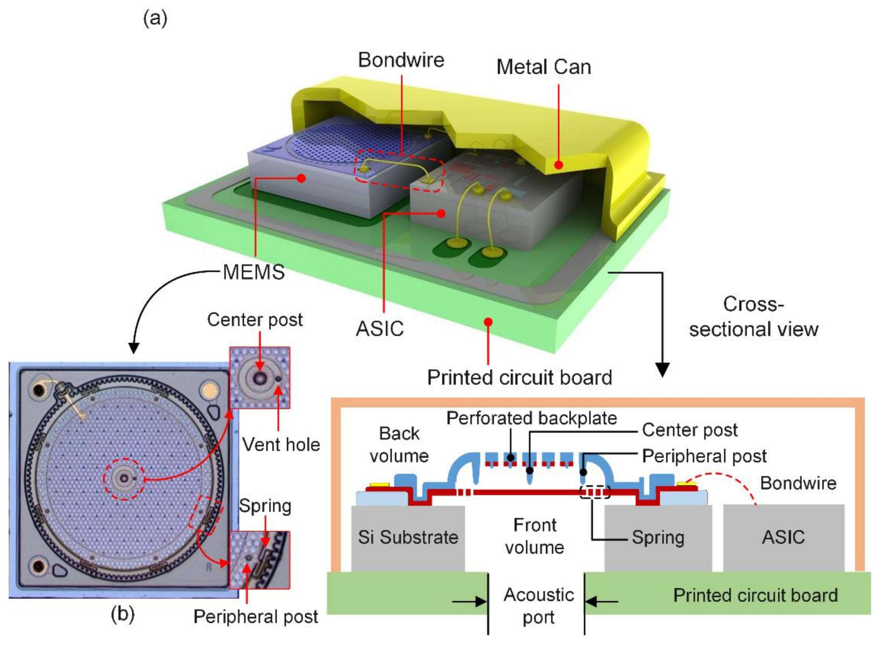
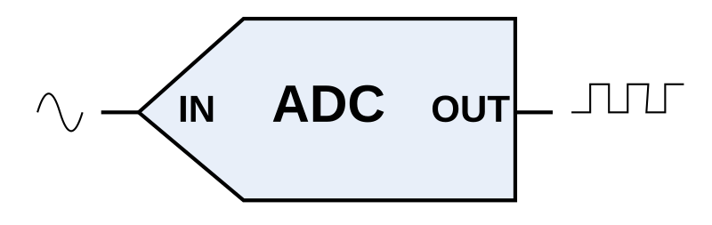
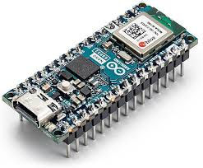
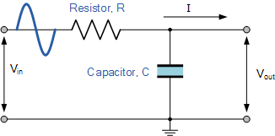
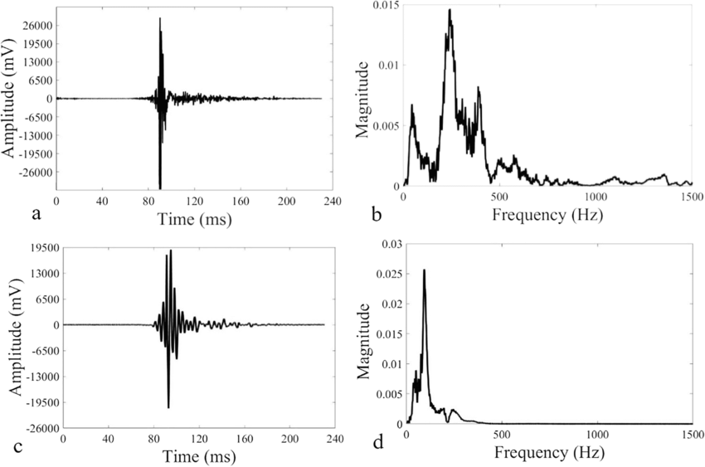
Perception Recap

Slide 3
Questions?

Slide 4
Class Overview
Lecture (~40 minutes)
Subsystem check-in (~20 minutes)

Slide 5
Intelligence: Lecture 1 of 2
Lecture 1: features, transformations, and mapping
Lecture 2: SLAM

Slide 6
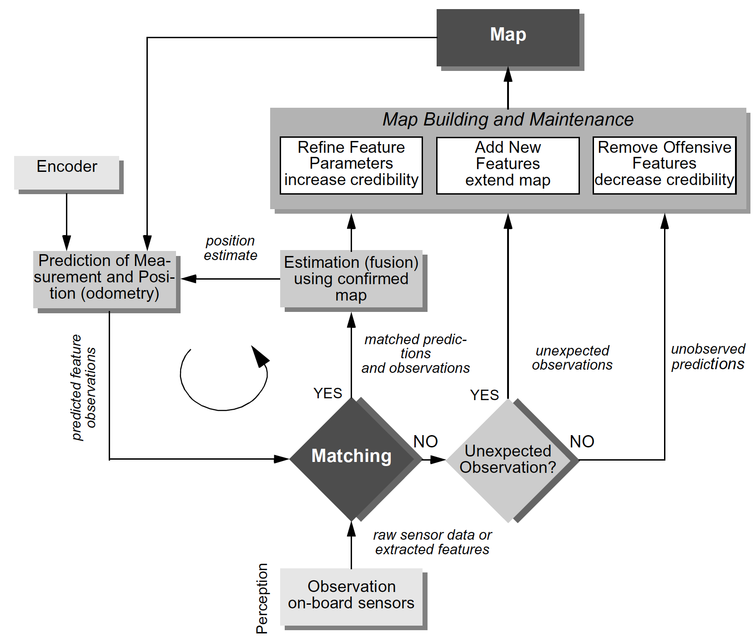
SLAM as an archetypical function
Mapping,
Feedback between Action and Perception
Localization
Perception

Slide 7
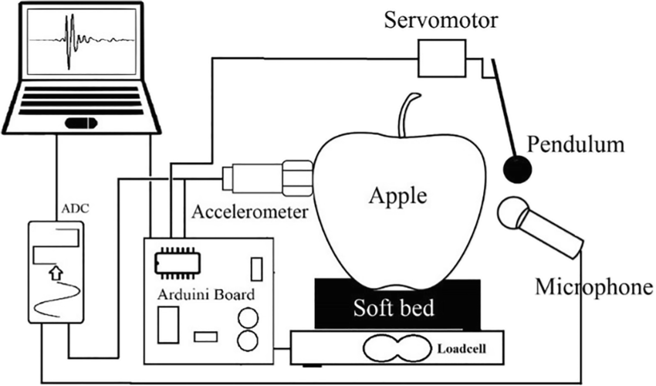
From Data to Features
Apple Testing

Slide 8
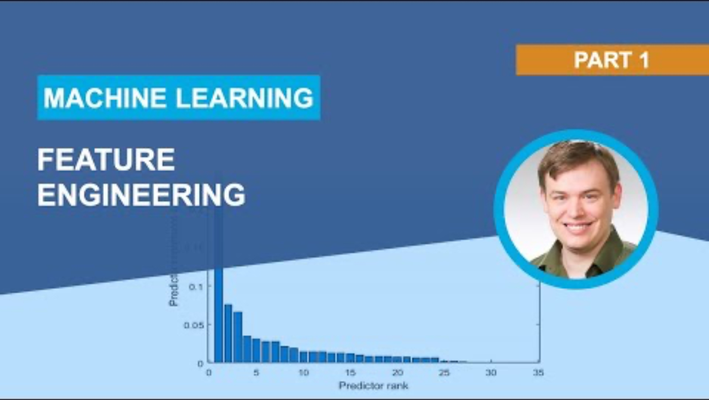
From Data to Features

Slide 9
From Data to Features
Spectral purity? Max amplitude?
Spectrum centroid?
Harmonic amplitude?
Apple Testing

Slide 10
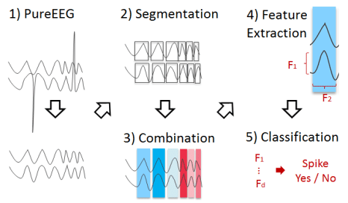
From Data to Features

Slide 11
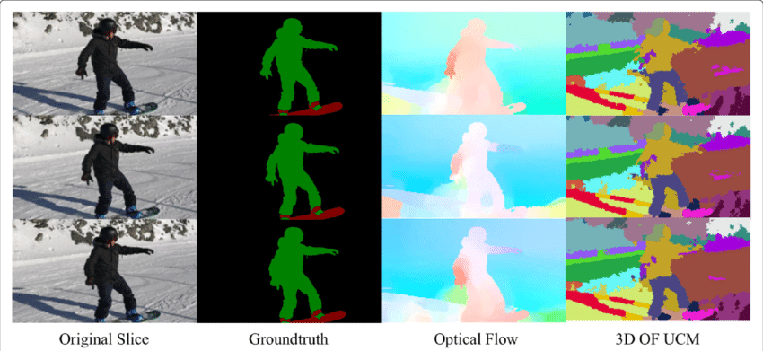
From Data to Features

Slide 12
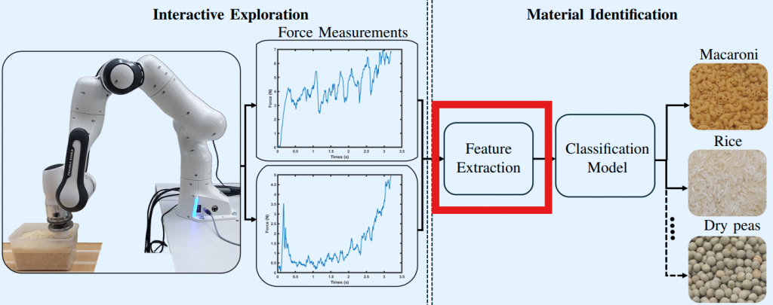
From Data to Features

Slide 13
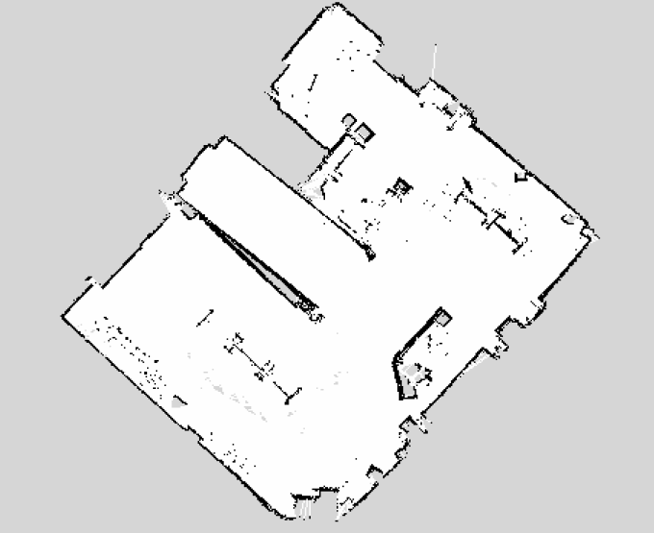
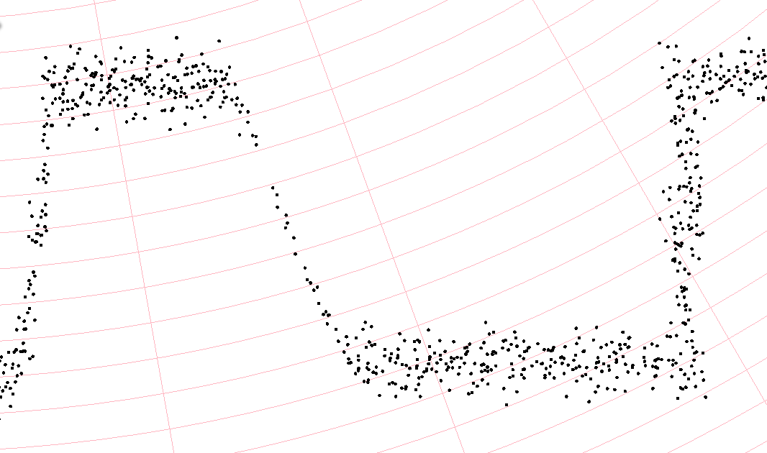
Features: Edges
How do we turn this into “walls” -- algorithmically?

Slide 14
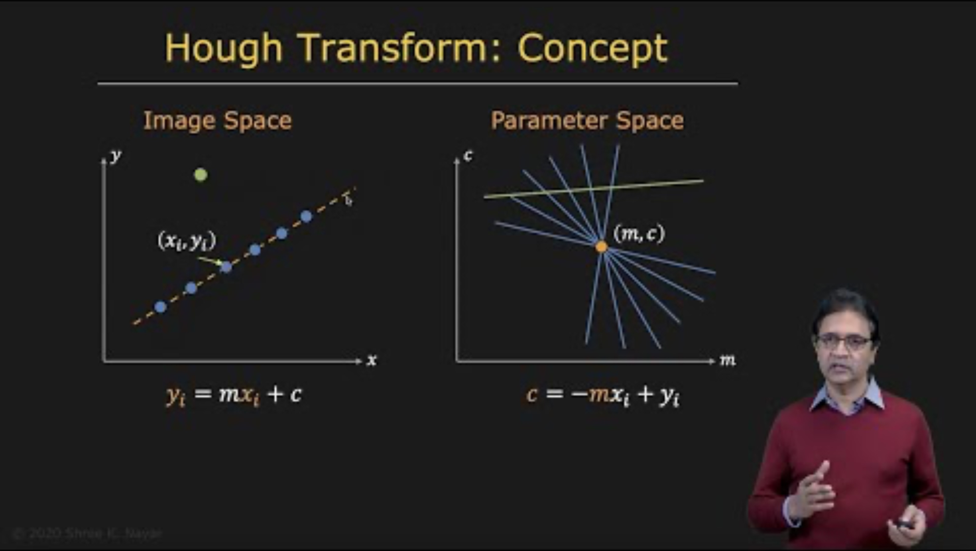
Features: Edges

Slide 15
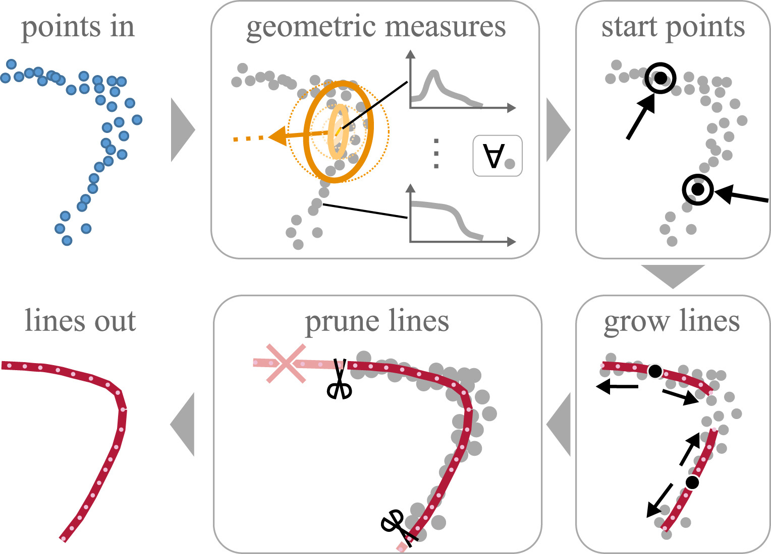
Features: Curved Edges
Generalized Hough Transform (GHT) works for curves – but expensive.
Alternatives are in research:

Slide 16
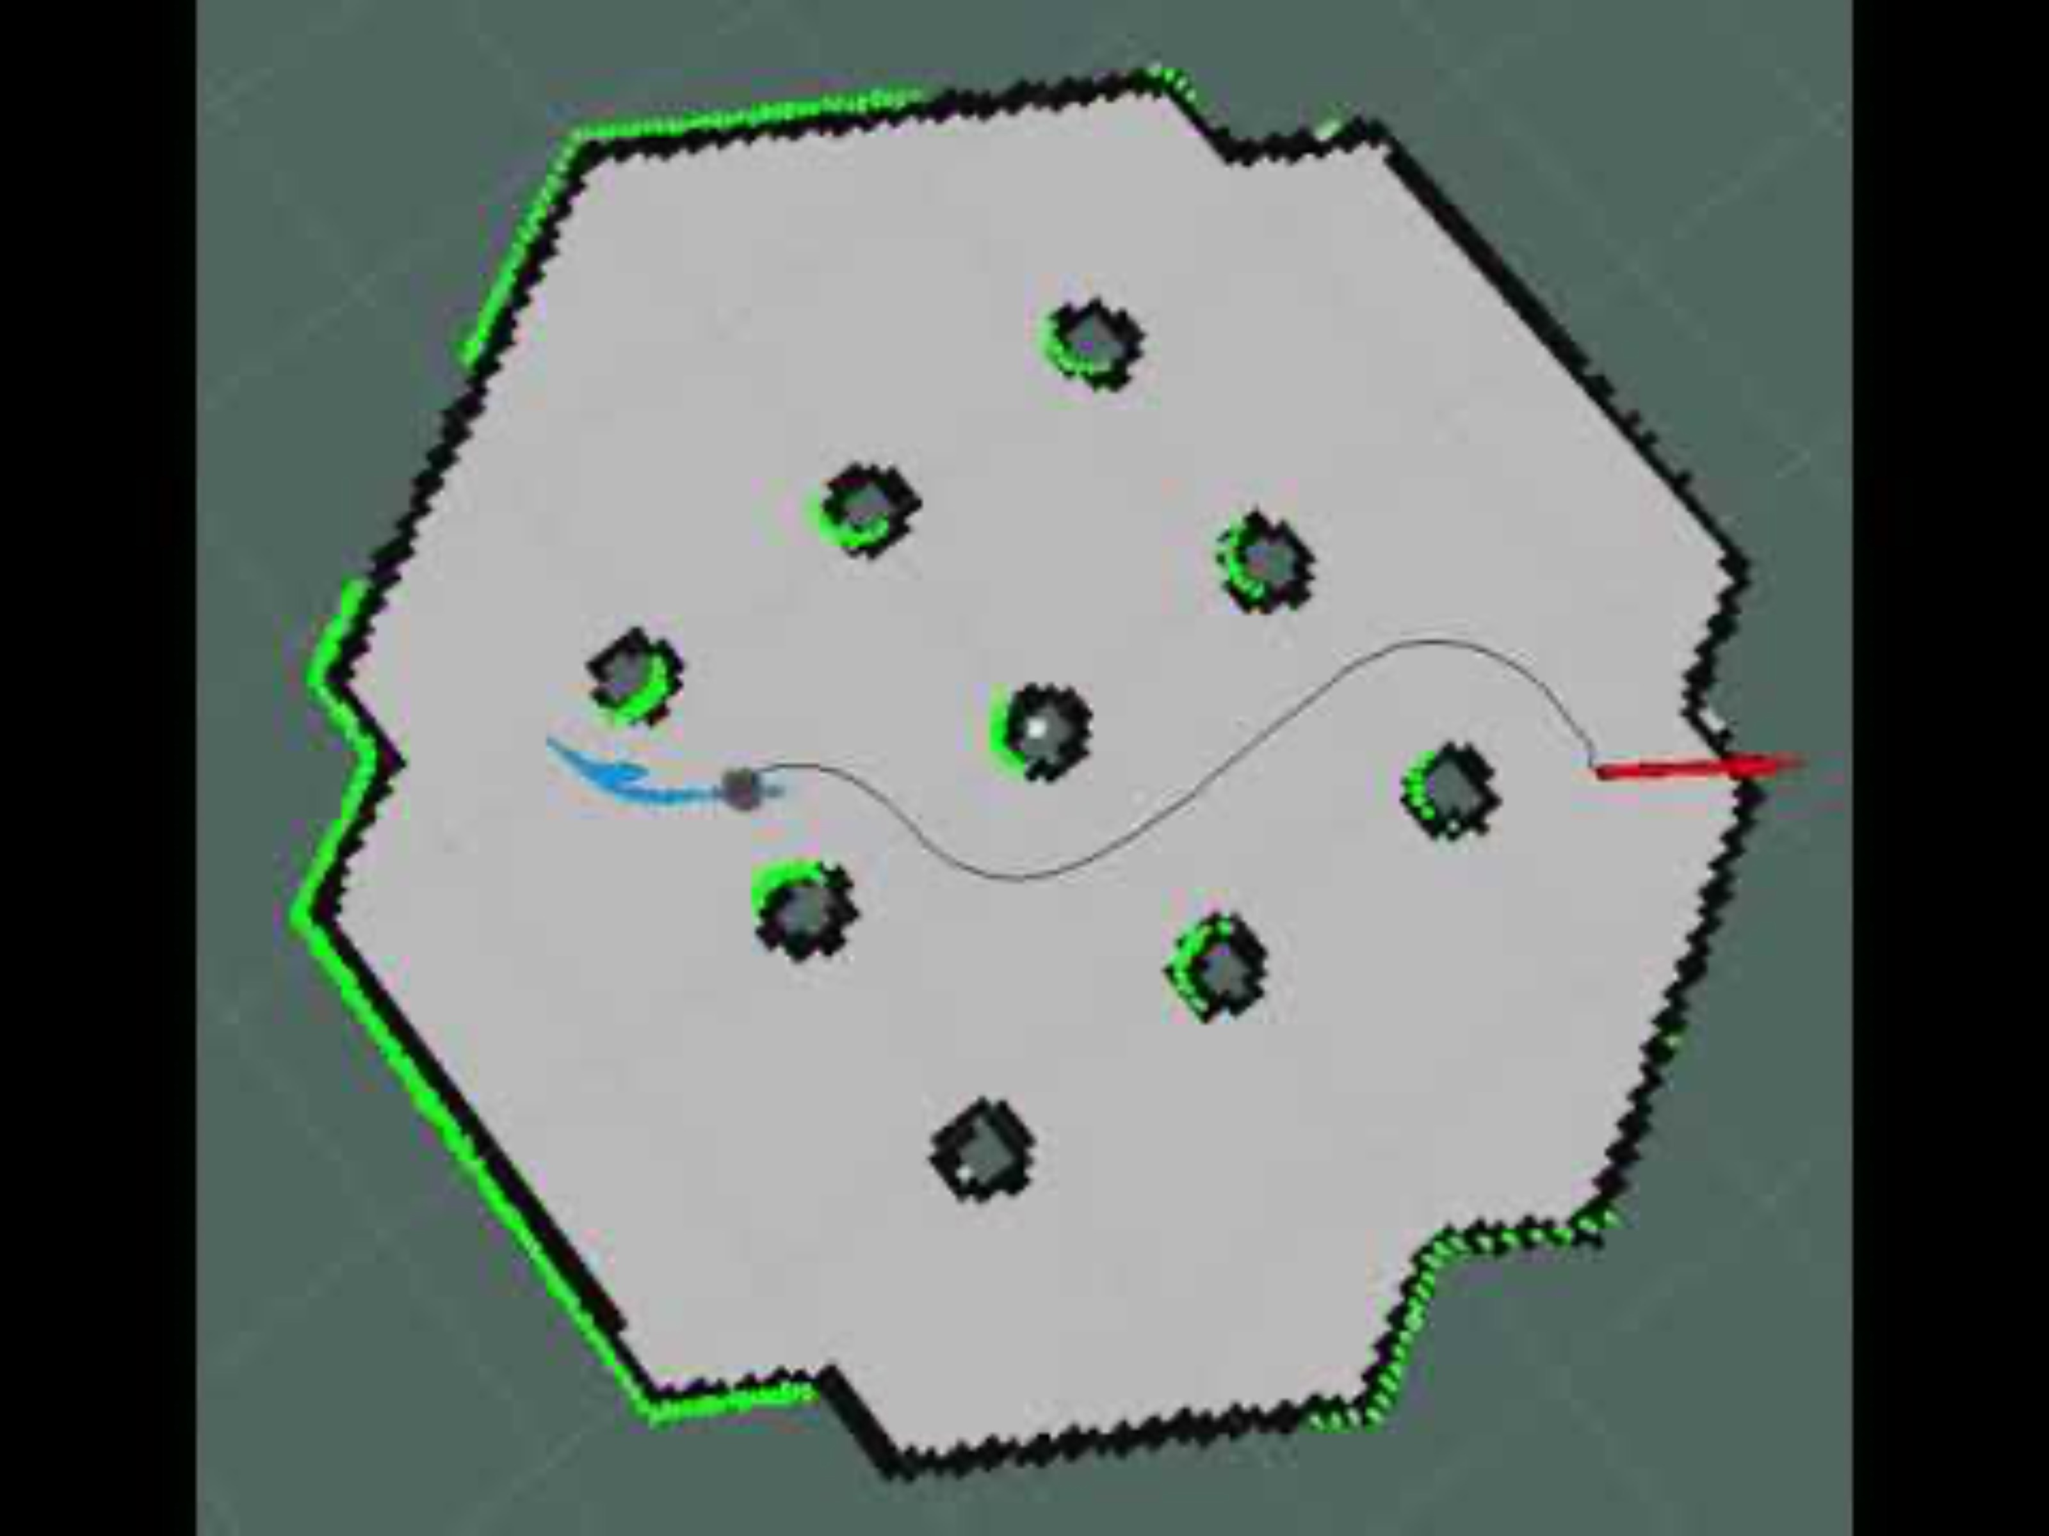
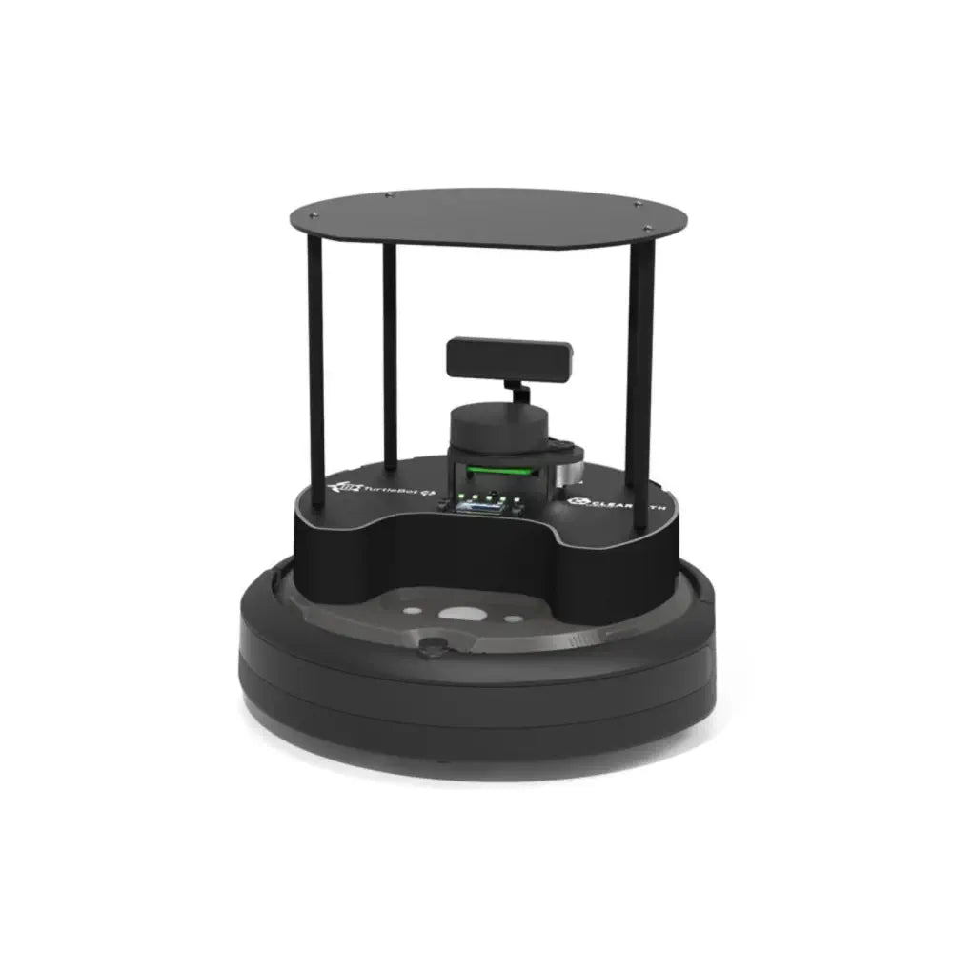

Slide 17
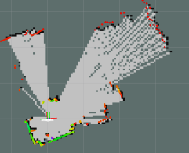
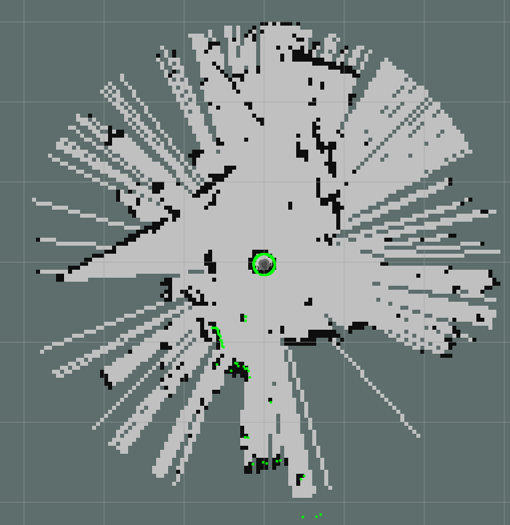
Features: Gone Wrong

Slide 18
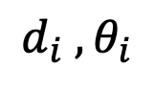
The World Frame
$$d_{i} , θ_{i}$$
(0,0)

Slide 19
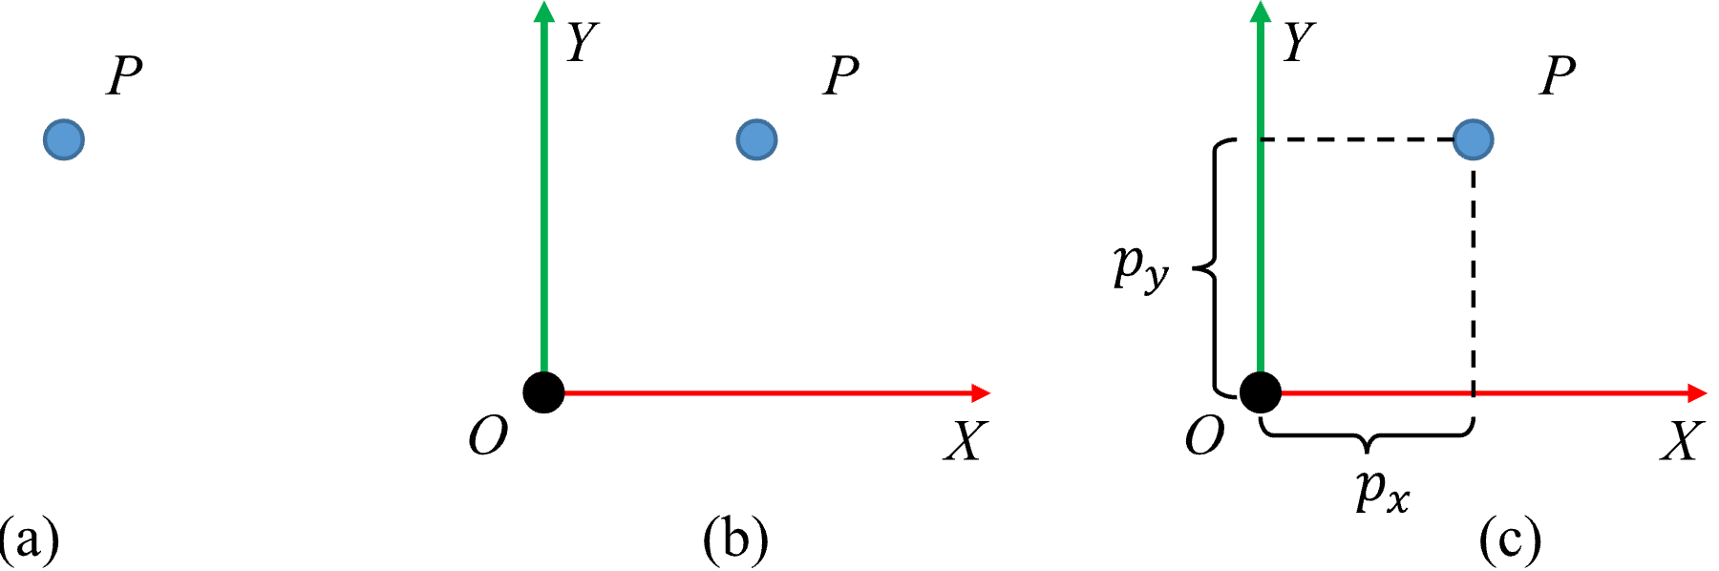
Coordinate Frames
A point means nothing without a reference coordinate frame

Slide 20
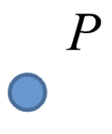
The World Frame
$$d_{i} , θ_{i}$$
(0,0)

Slide 21
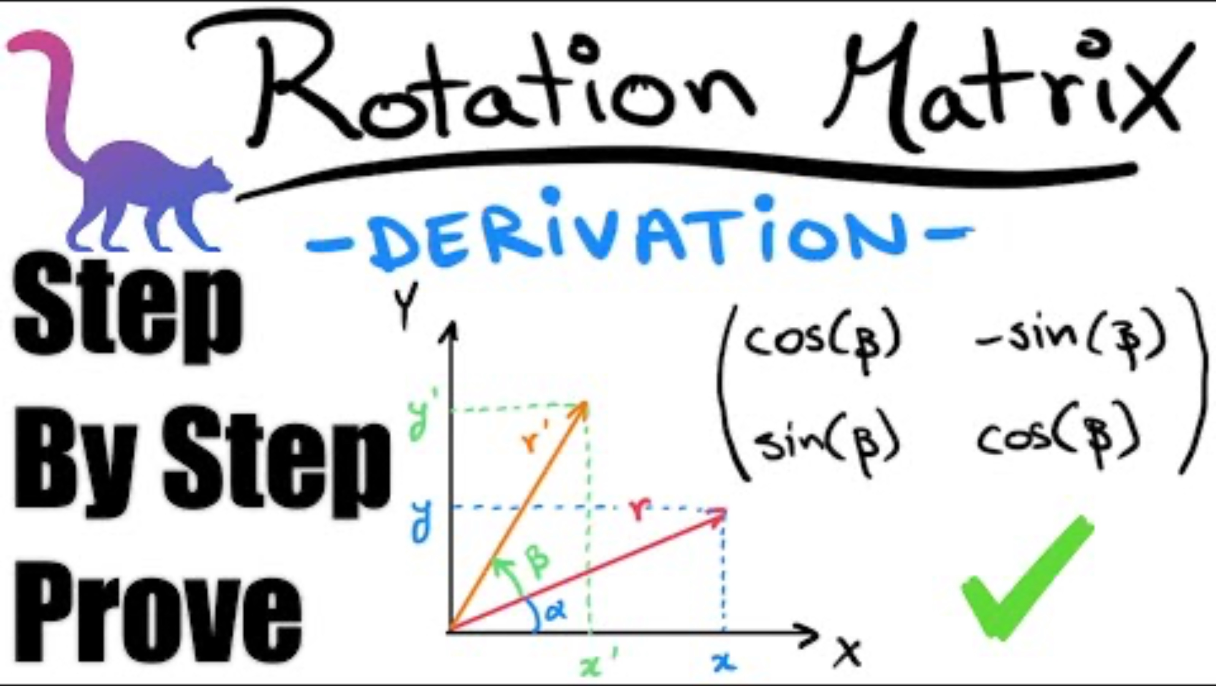
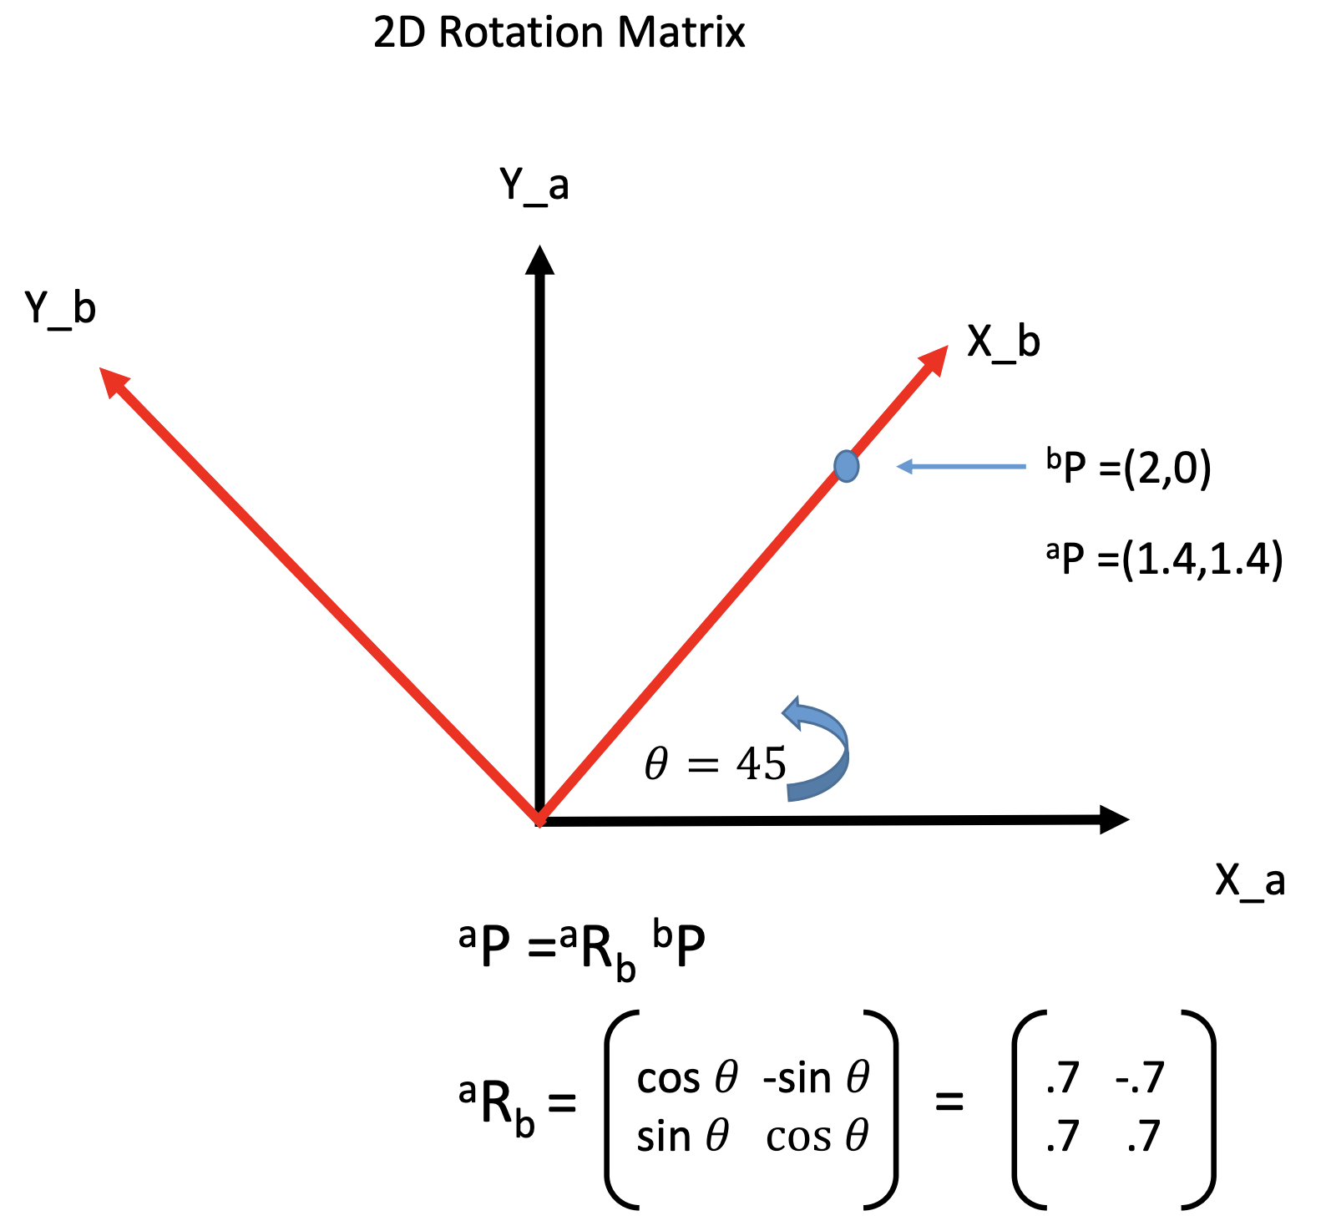
Frame Transformations: Rotation

Slide 22
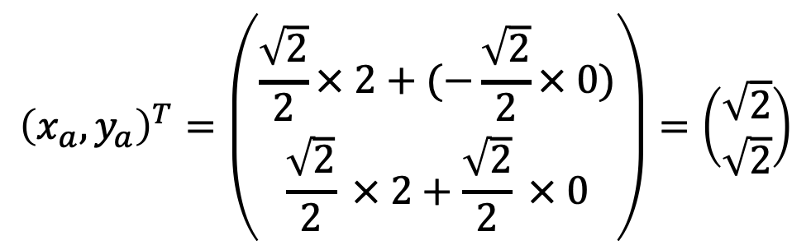
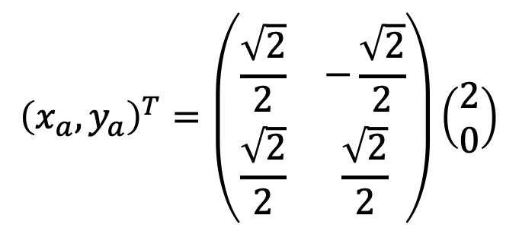
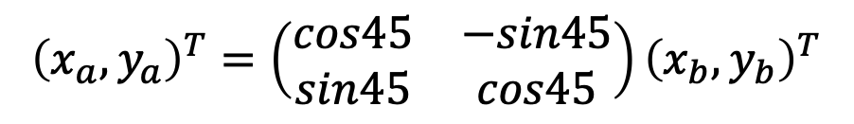
Frame Transformations: Rotation
$${\left(x_{a},y_{a}\right)}^{T}=\left(\begin{matrix}cos45 & −sin45 \\ sin45 & cos45\end{matrix}\right){\left(x_{b},y_{b}\right)}^{T}$$
$${\left(x_{a},y_{a}\right)}^{T}=\left(\begin{matrix}\frac{\sqrt{2}}{2} & −\frac{\sqrt{2}}{2} \\ \frac{\sqrt{2}}{2} & \frac{\sqrt{2}}{2}\end{matrix}\right)\left(\begin{matrix}2 \\ 0\end{matrix}\right)$$
$${\left(x_{a},y_{a}\right)}^{T}=\left(\begin{matrix}\frac{\sqrt{2}}{2}× 2+(−\frac{\sqrt{2}}{2}× 0) \\ \frac{\sqrt{2}}{2} × 2+\frac{\sqrt{2}}{2} × 0\end{matrix}\right)=\left(\begin{matrix}\sqrt{2} \\ \sqrt{2}\end{matrix}\right)$$
(rotates b to a)

Slide 23
The World Frame
$$d_{i} , θ_{i}$$
(0,0)

Slide 24
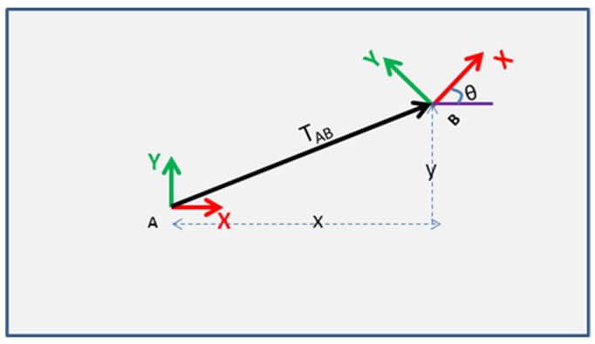
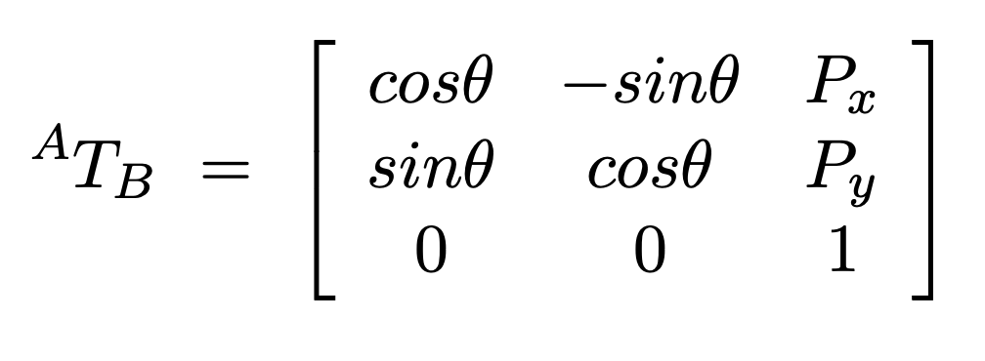
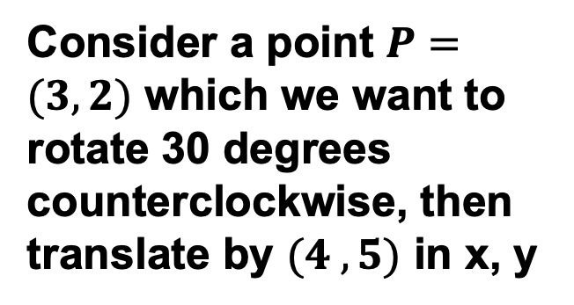
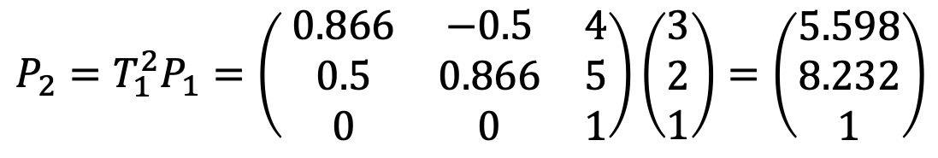
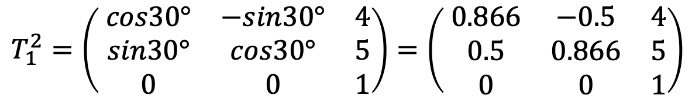
Frame Transformations: Adding Translation
Translation in x and y
$$T_{1}^{2}=\left( \begin{matrix}cos30° & −sin30° & 4 \\ sin30° & cos30° & 5 \\ 0 & 0 & 1\end{matrix}\right)=\left( \begin{matrix}0.866 & −0.5 & 4 \\ 0.5 & 0.866 & 5 \\ 0 & 0 & 1\end{matrix}\right)$$
Consider a point $P=(3,2)$ which we want to rotate 30 degrees counterclockwise, then translate by $(4 , 5)$ in x, y
$$P_{2}=T_{1}^{2}P_{1}=\left( \begin{matrix}0.866 & −0.5 & 4 \\ 0.5 & 0.866 & 5 \\ 0 & 0 & 1\end{matrix}\right)\left(\begin{matrix}3 \\ 2 \\ 1\end{matrix}\right)=\left(\begin{matrix}5.598 \\ 8.232 \\ 1\end{matrix}\right)$$

Slide 25
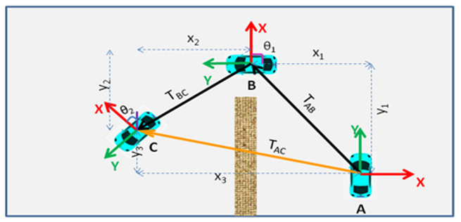
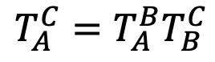
Frame Transformations: Successive Transforms
$$T_{A}^{C}=T_{A}^{B}T_{B}^{C}$$
(transforms A to C)

Slide 26
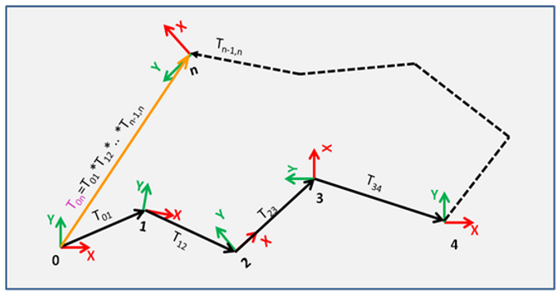
Frame Transformations: Successive Transforms

Slide 27
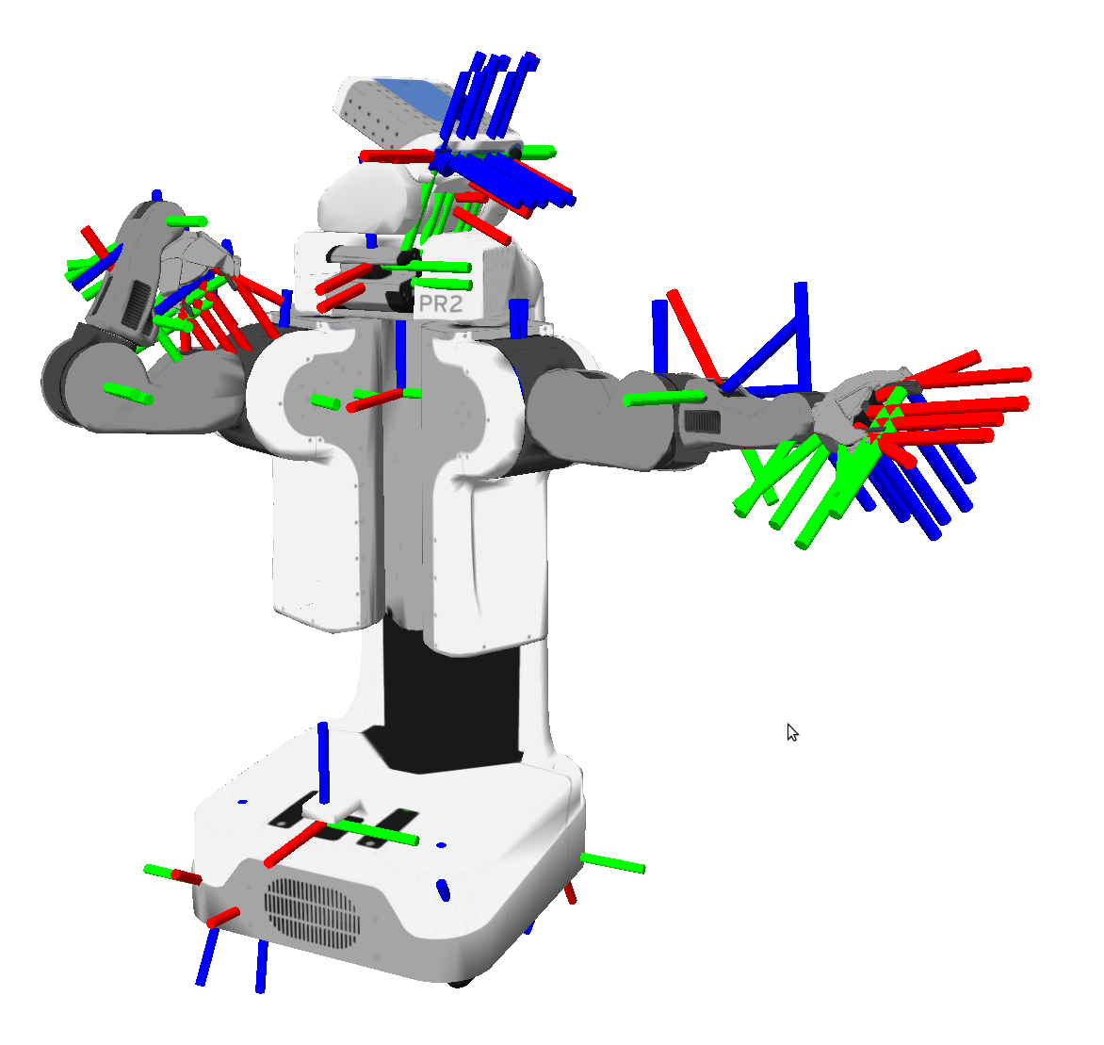
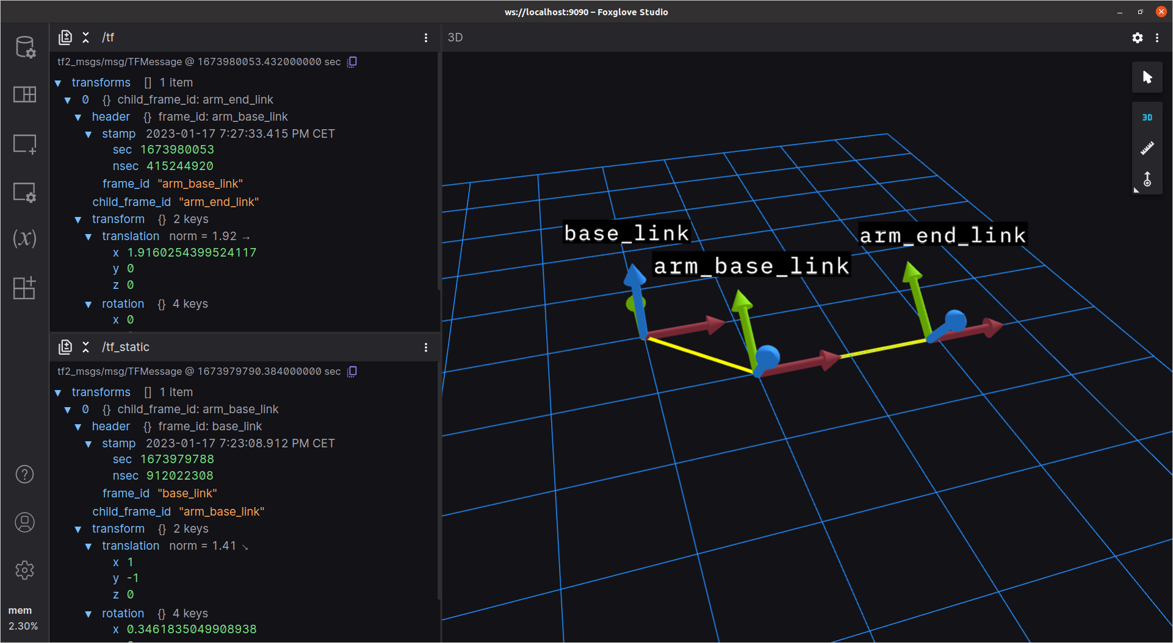
Frame Transformations: ROS TF2

Slide 28
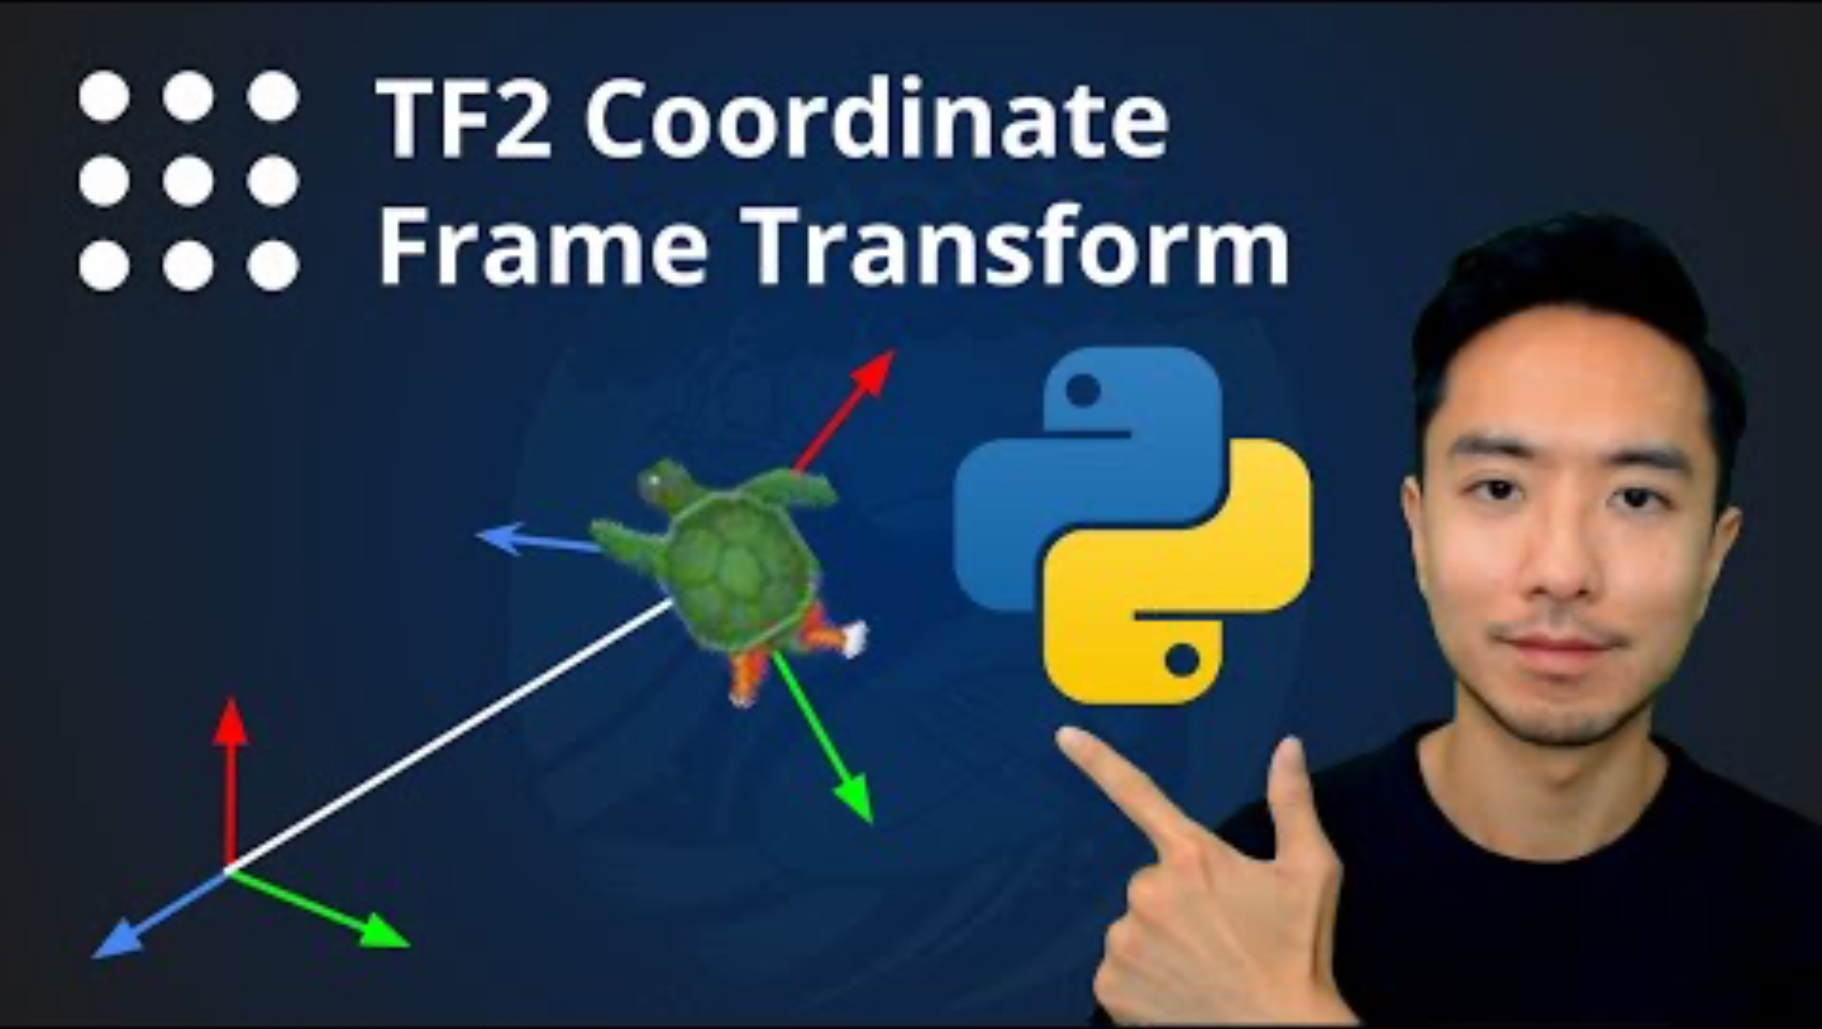
Frame Transformations: ROS TF2

Slide 29
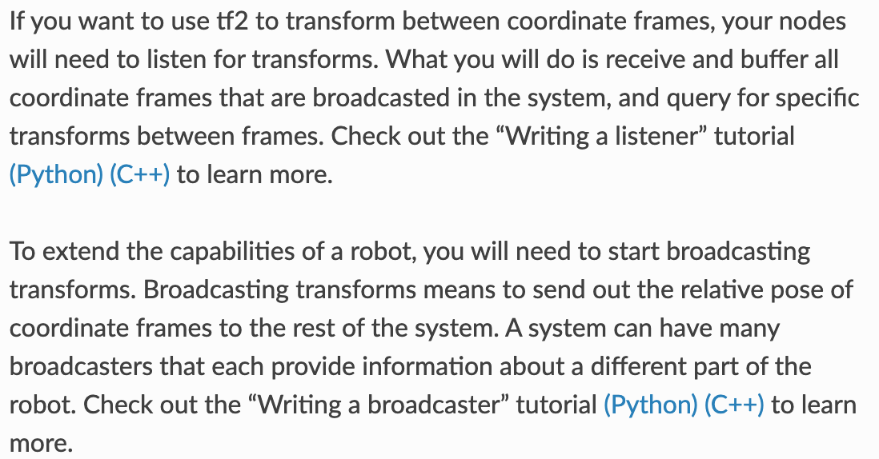
Frame Transformations: ROS TF2

Slide 30
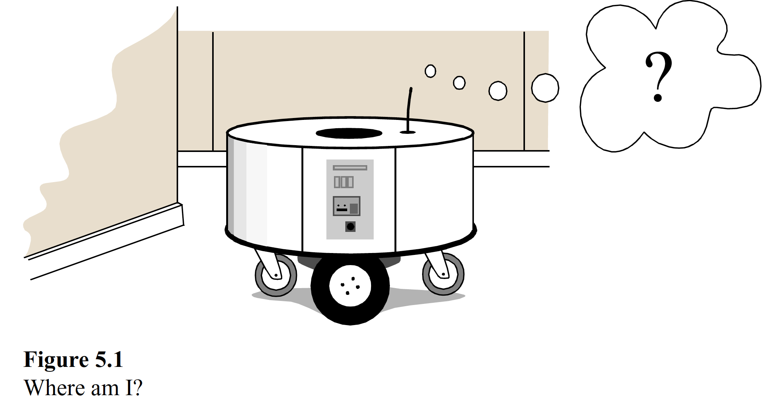
Mapping

Slide 31
Mapping

Slide 32
The World Frame
$$d_{i} , θ_{i}$$
(0,0)

Slide 33
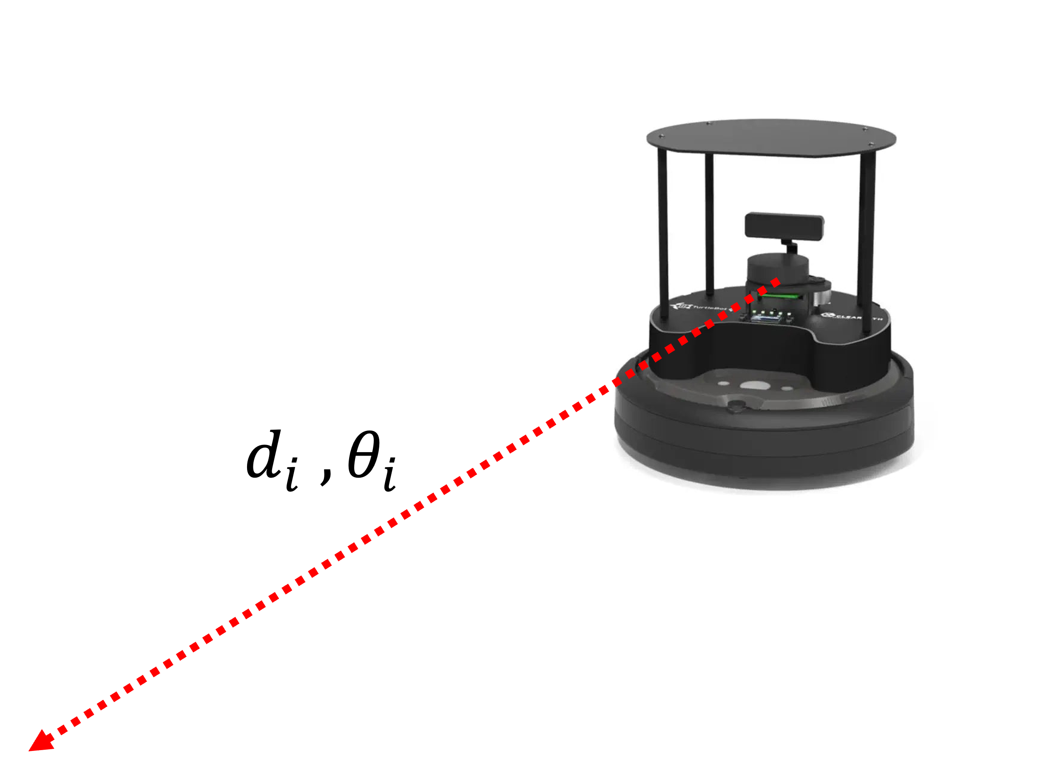
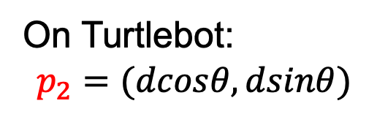
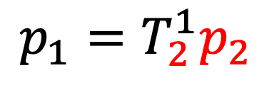
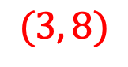
Mapping: Adding to the World Frame
On Turtlebot:
$$p_{2}=(dcosθ, dsinθ)$$
$$p_{1}=T_{2}^{1}p_{2}$$
1) Find rigid transformation matrix from robot frame to world frame
2) Transform point in robot frame to world frame
3) Add to graph
$$(3, 8)$$
(0,0)

Slide 35

Mapping: Adding to the World Frame
$$p_{1}=T_{2}^{1}p_{2}$$
1) Find rigid transformation matrix from robot frame to world frame
$$(3, 8)$$
(0,0)

Slide 36


Mapping: Adding to the World Frame
$$p_{1}=T_{2}^{1}p_{2}$$
1) Find rigid transformation matrix from robot frame to world frame
$$(3, 8)$$
Localization
(aided by odometry)
(0,0)

Slide 37
Lecture (~40 minutes)
Subsystem check-in (~20 minutes)
Questions?
Questions?
Lecture 1: features, transformations, and mapping
Lecture 2: SLAM

Slide 38

693H Robotic Subsystems
First Design Review Presentations are 2/10, 2/12
-I will randomly select which two groups present which day. Be ready on 2/10.
-Link to presentation templates are posted on Discord + Laulima

Slide 39

693H Robotic Subsystems
Motors, drive electronics, encoders, PID controllers, top-down tracking
Sensor suite (IMU, prox.), calibration code, general IO (buttons and LEDs)
Mobility
Perception
Compute and Power
Control and Planning
Battery and charging, wireless comms, GPIO and power distribution routing
microROS, ROS2, Gazebo simulation, enclosure design
Mechanics / Prototyping
Coding
PCB Design

